Slide 1
Expansion Draft Analysis
By Gavin Green

Slide 2

The Expansion Draft is Unique
The once-in-a-franchise’s-history expansion draft offers the opportunity snatch players from almost any team
By leveling the playing field a bit more, teams have offered unique takes in the recent years
Charlotte FC almost made $1 million in GAM through expansion draft trades
LAFC and Atlanta United both utilized trades to pick up Laurent Ciman and Julian Gressel, respectively
St. Louis CITY picked up contributors directly into their first team, including Nico Gioacchini and Indiana Vassilev

Slide 3

Analyzing the Expansion Draft
The goal of this analysis is to find any trends associated with the expansion draft in the most recent expansionary phase starting with the 2016 Expansion Draft
One way to measure influence of the expansion draft is through how important the players chosen are to the team
Seeing as the publicly available data would have been hard to come by, I used combined minutes from expansion players as a proxy for impact on the team from the expansion draft

Slide 4
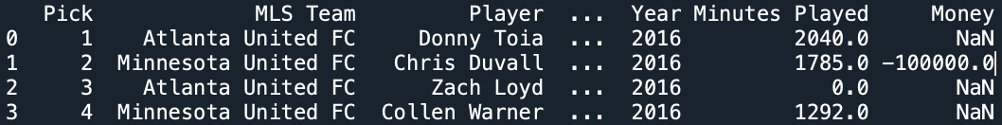
The Dataset
The dataset includes each expansion draft pick since 2016.
It includes the minutes they played, allocation money exchanged through trades, and any notes on the player (if they were traded, etc.)

Slide 5


X-axis: Adjusted Minutes Played
Total minutes played: aggregated minutes played for each player over the course of the season
In the case of a trade, minutes played for the individual player becomes the minutes played for the acquired player
To adjust for trades for allocation money, each 100k adds 200 minutes through adjusted minutes
Minutes adjusted accordingly for Nashville and Inter Miami to account for COVID season

Slide 6

Y-axis: Total Points
Once aggregated by team, add independent variable for total points won in their first season
Adjusted points for Nashville and Inter Miami due to COVID Season

Slide 7
3 Outliers Identified: LAFC, ATL UTD, and STL CITY SC
LAFC: High roster spend and high impact from El Tri mainstay Carlos Vela
Atlanta: Very high roster spend and extremely high impact from future premier league player of the month Miguel Almiron
STL City: drastically outpaced their expected goals (very lucky over the course of a season)

Slide 8
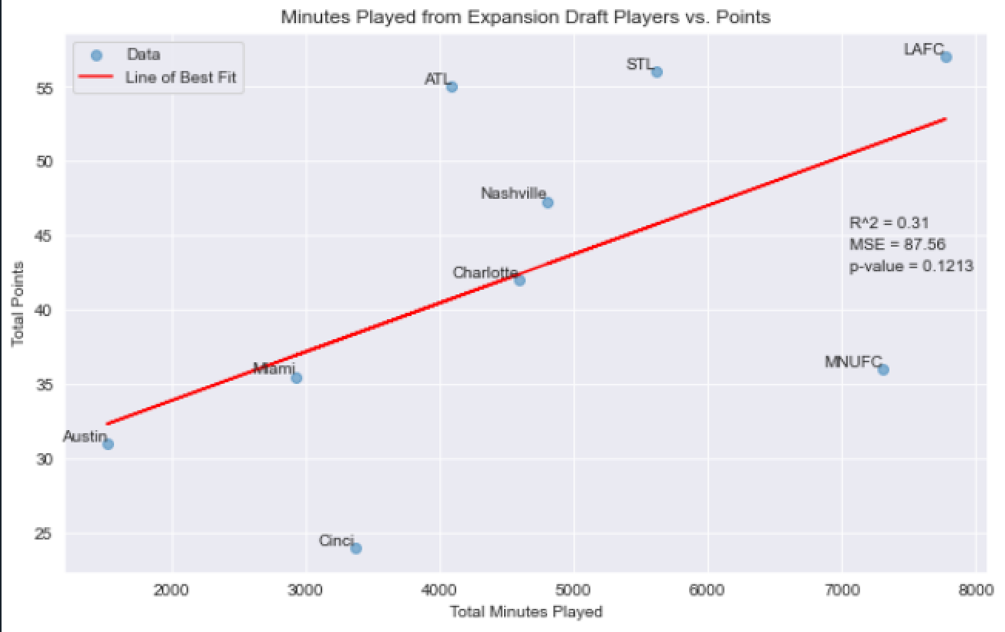
Graph 1: Minutes Played vs. Total Points

Slide 9
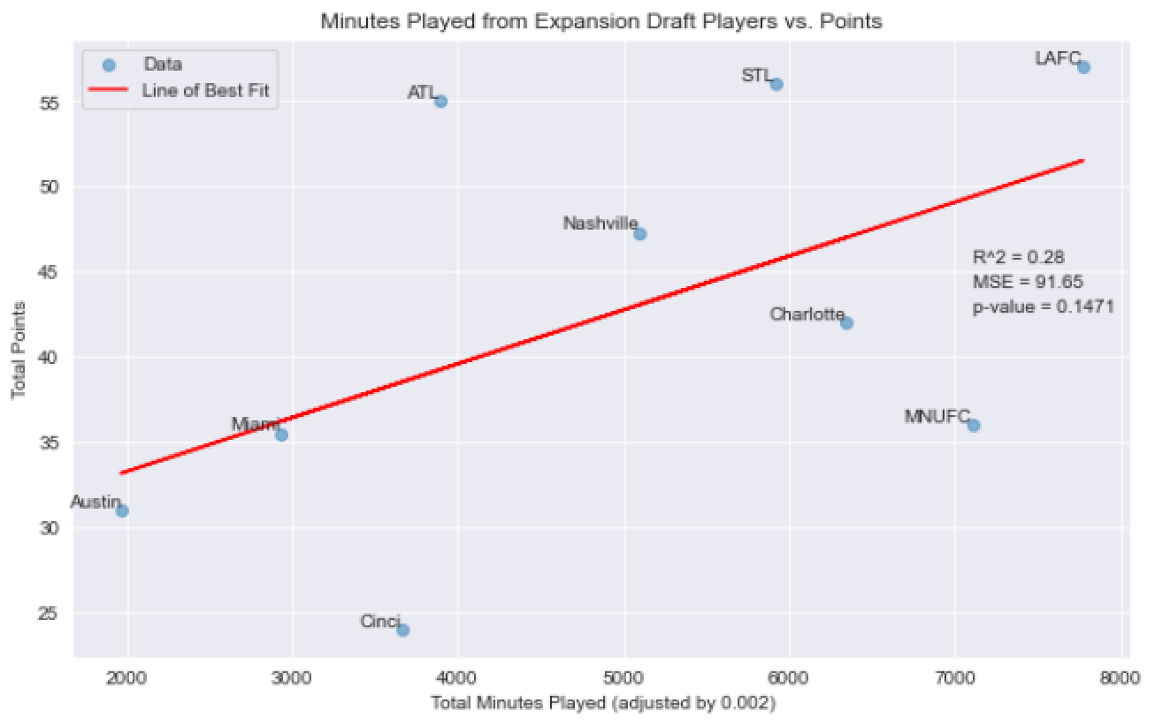
Graph 2: Adjusted Minutes Played vs. Total Points

Slide 10
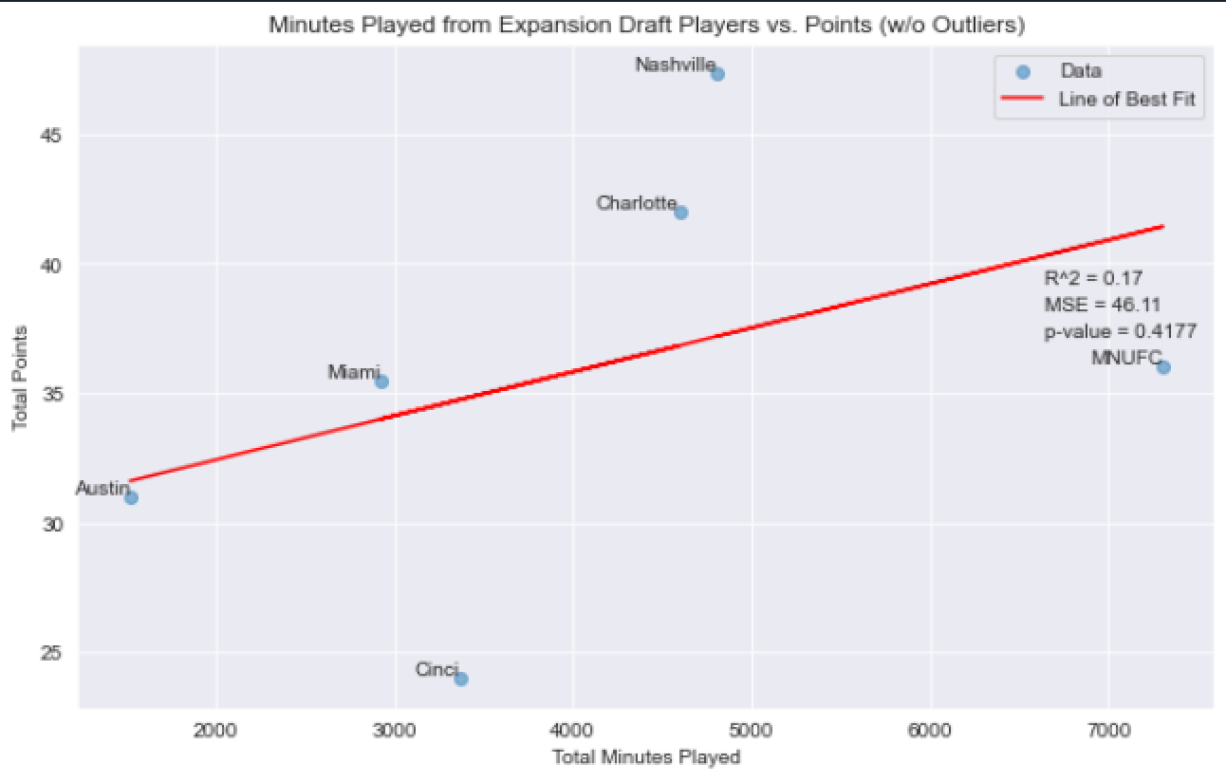
Graph 3: Minutes Played vs. Total Points (No Outliers)

Slide 11
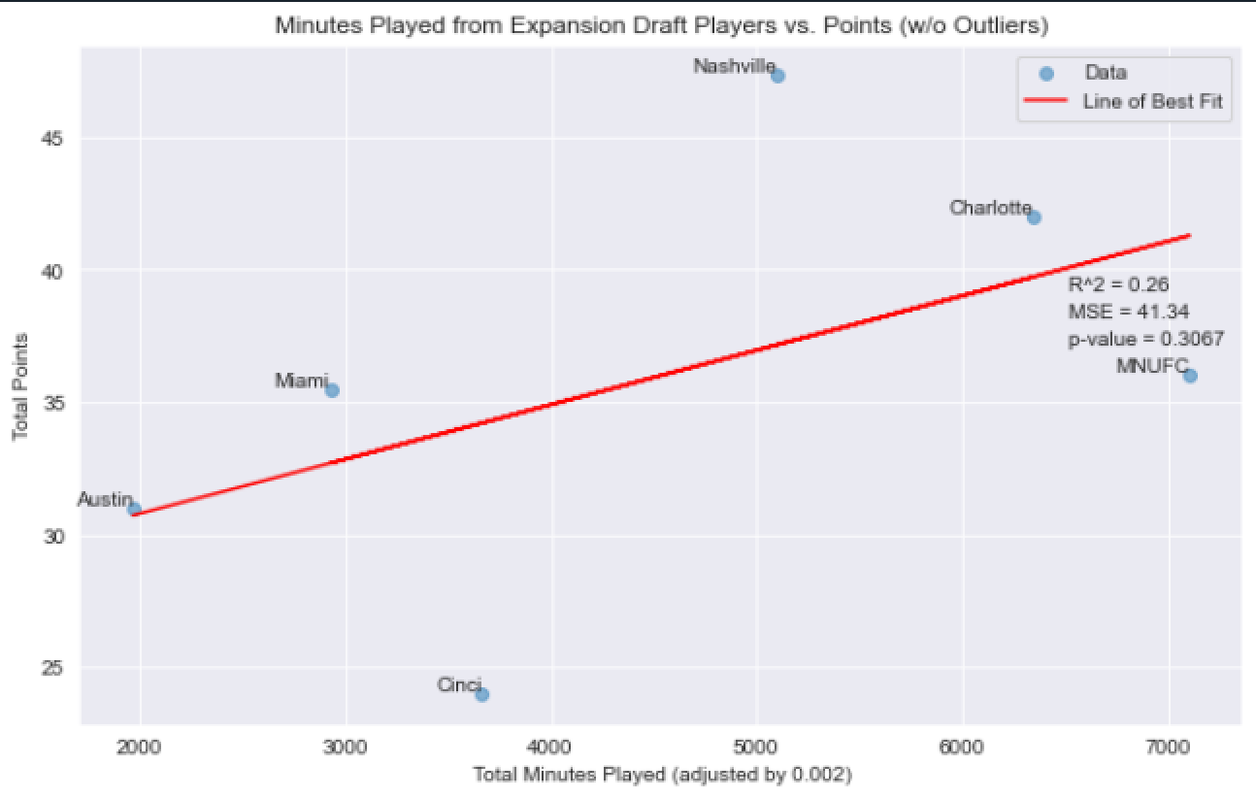
Graph 4: Adjusted Minutes Played vs. Total Points (no Outliers)

Slide 12
Results
Out of all these graphs, the strongest predictor of total points was purely expansion draft impact via minutes
Graph 1 implies that every 300 minutes played by expansion draft picks leads to an overall point increase in the standings
Any control imposed, whether adjusted minutes played or outliers taken out, dropped the confidence level (p-value) and decreased the impact variable (R^2-value)

Slide 13
Interpretation
The predictive power of minutes played on total points is fairly strong and statistically significant
However, avenue for this impact might not be all through the expansion draft players
Expansion minutes could simply be an indicator of a well-run organization and a cohesive plan
The results imply that receiving allocation money doesn’t do much to increase the points tally at the end of the season

Slide 14
Caveats
This data was non-verified publicly available data
Very low sample size
Confidence outside of traditionally accepted statistically significant level (p>0.1), although, in my experience, this is fairly significant for sports data
Minutes is a rather abstract proxy for how good an expansion pick performed

Slide 15
Conclusion
An expansion draft pick’s impact on the field is directly correlated with the overall success of the team
While there are plenty of caveats, an impactful expansion draft class is most certainly an indicator of a well-run organization

Slide 16
Further Improvements
Better data to measure impact of player than just minutes (xg, goals added, expected threat, goals subtracted for defenders)
Extend timeline to 2+ years after expansion
Extend to pre-2016 other expansion drafts

